Slide 1
Advanced Database Management Systems (CSC-234)
The MongoDB Aggregation Framework

Slide 2
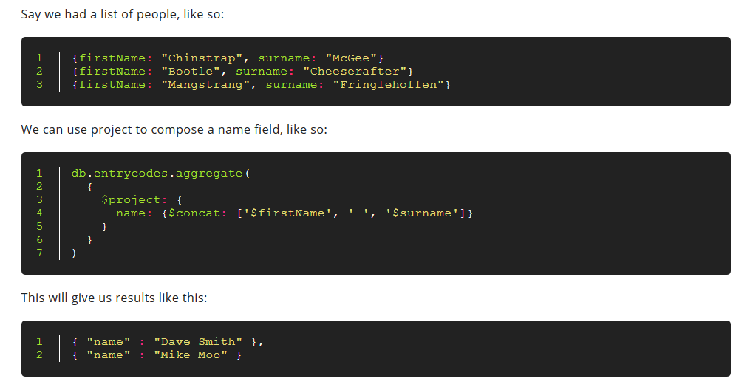
Creating new fields with $project

Slide 3
Exercise
Look up string operators for aggregation from the link below
https://docs.mongodb.com/manual/reference/operator/aggregation/
Capitalize all names in your people db

Slide 4
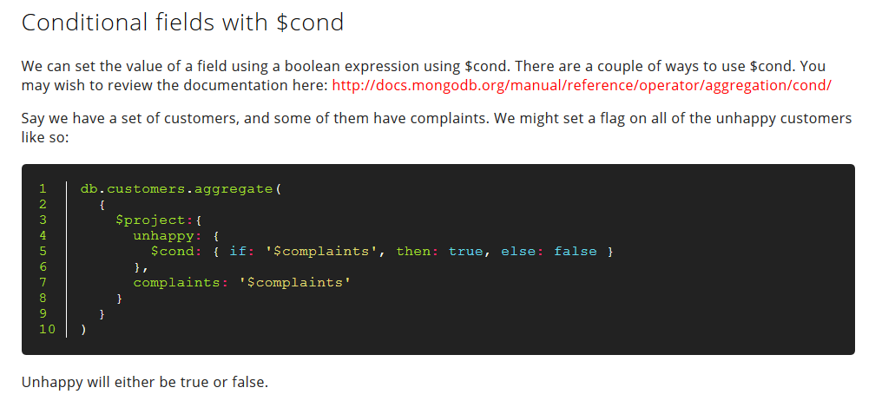

Slide 5


Slide 6


Slide 7
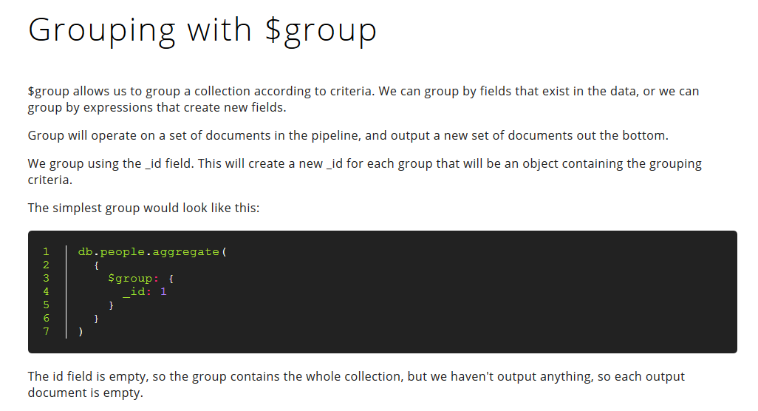

Slide 8
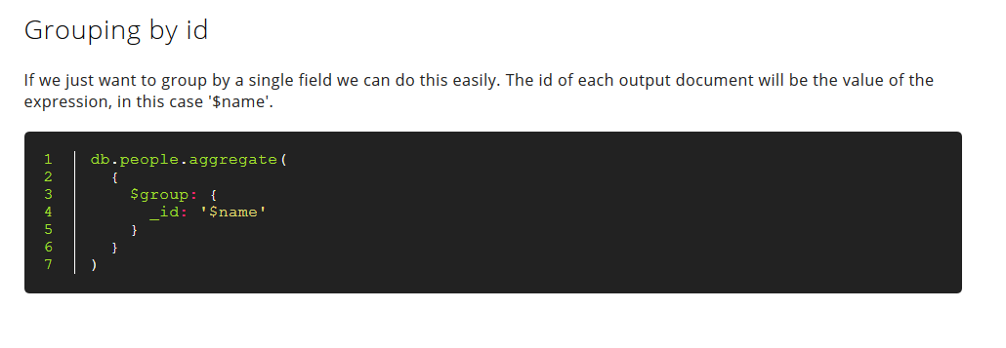

Slide 9
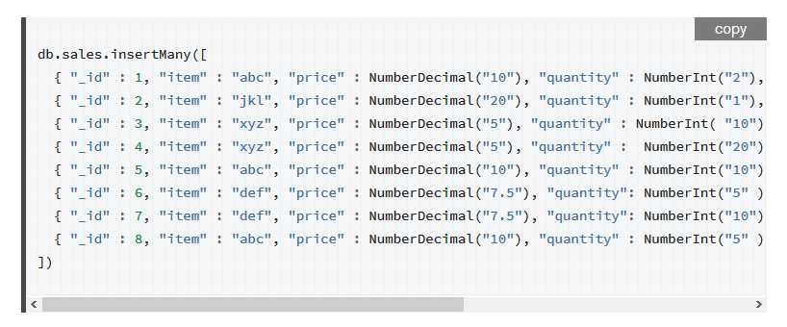

Slide 10
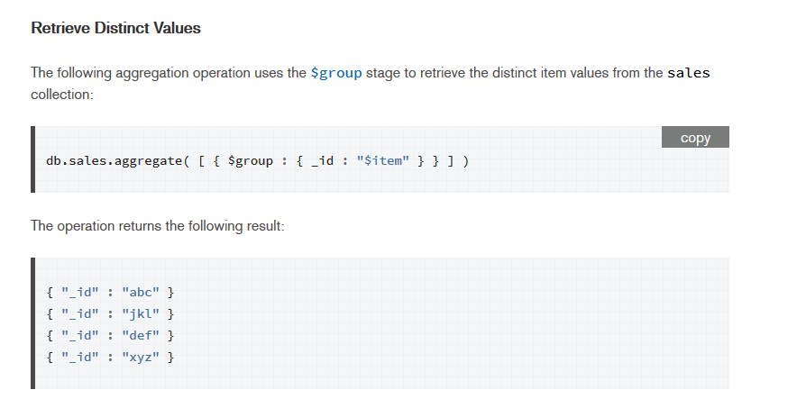

Slide 11


Slide 12
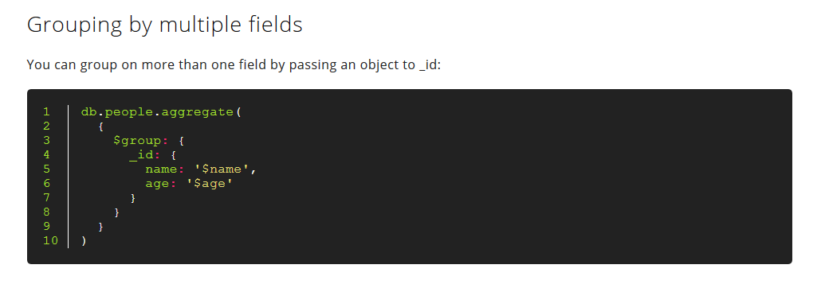

Slide 13


Slide 15
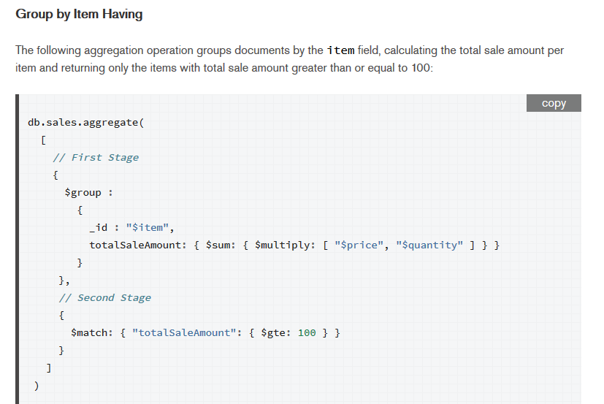

Slide 16
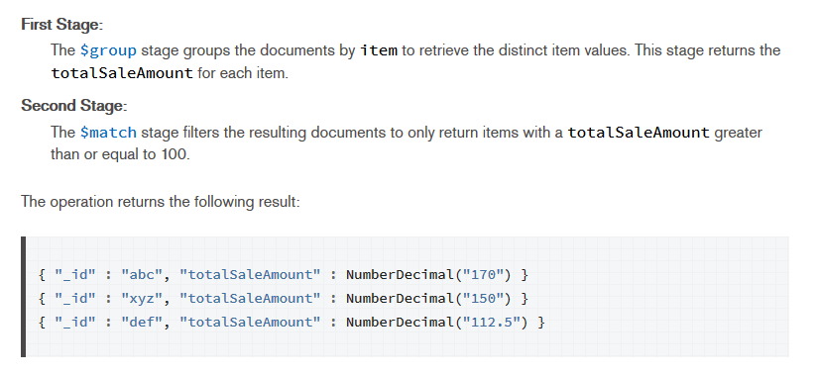

Slide 17


Slide 18
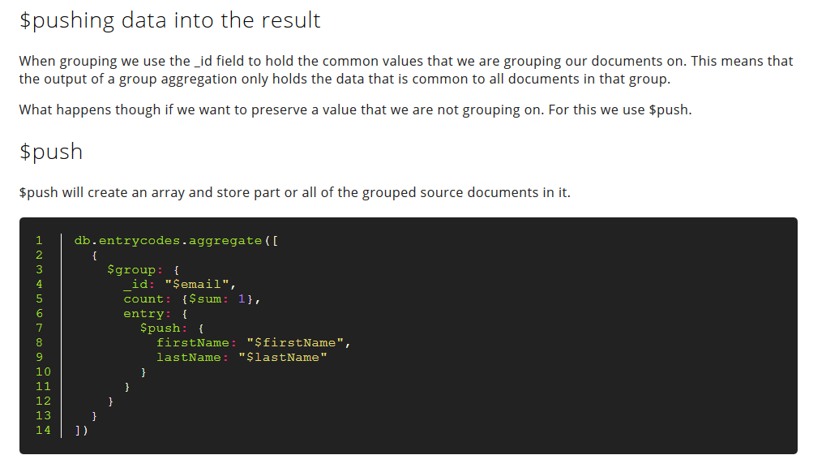

Slide 19
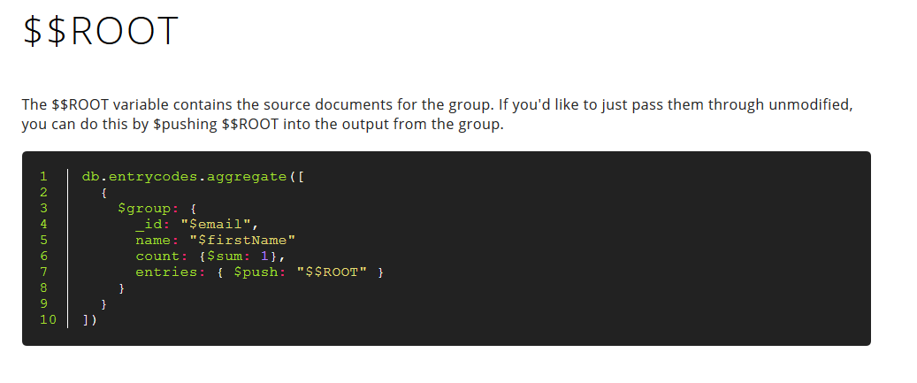

Slide 20
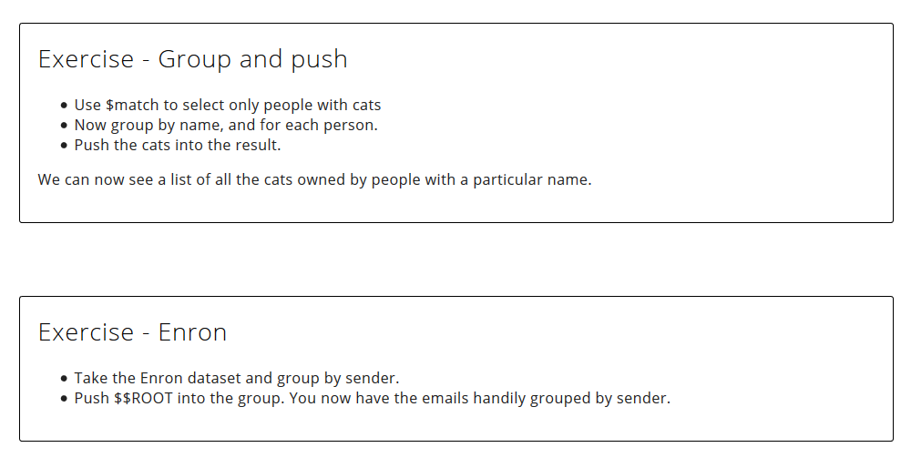

Slide 21


Slide 22
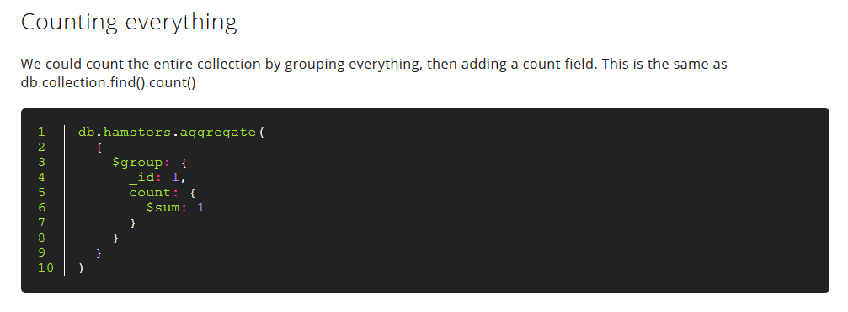

Slide 24
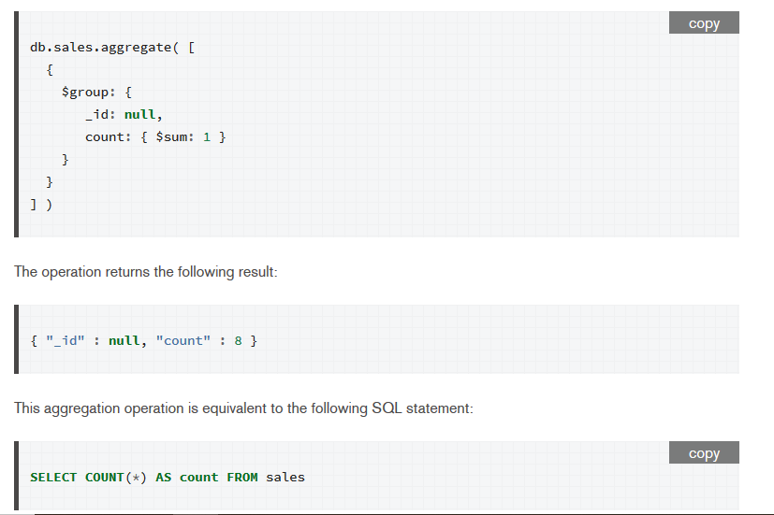

Slide 25
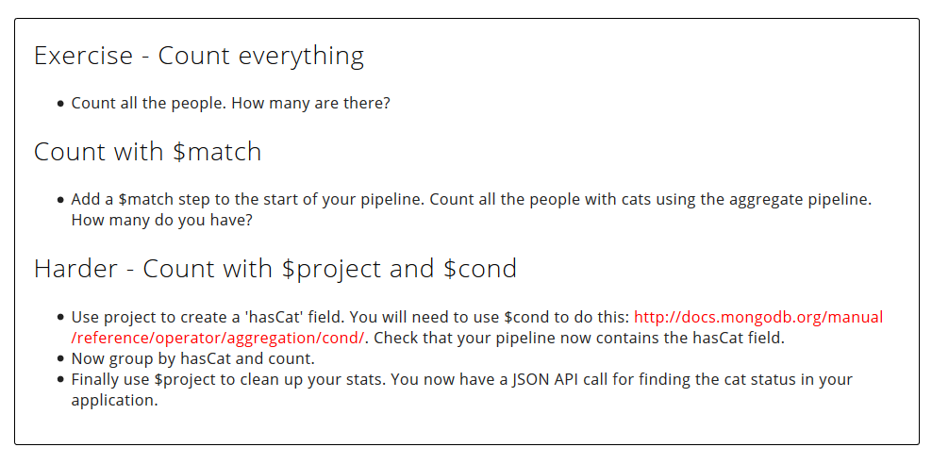
https://docs.mongodb.com/manual/reference/operator/aggregation/cond/

Slide 26
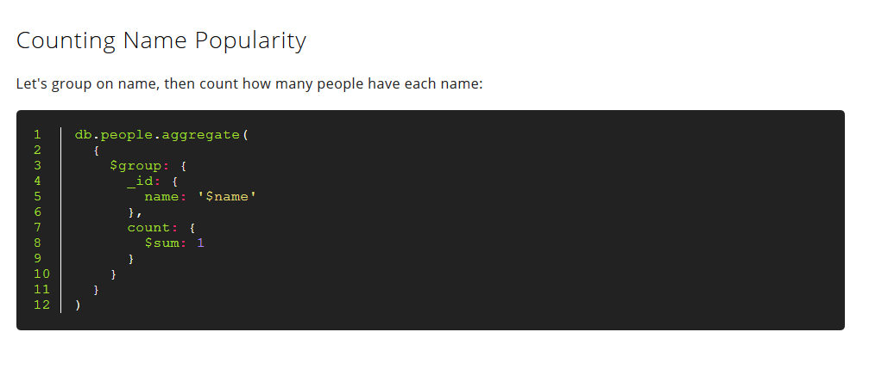

Slide 27
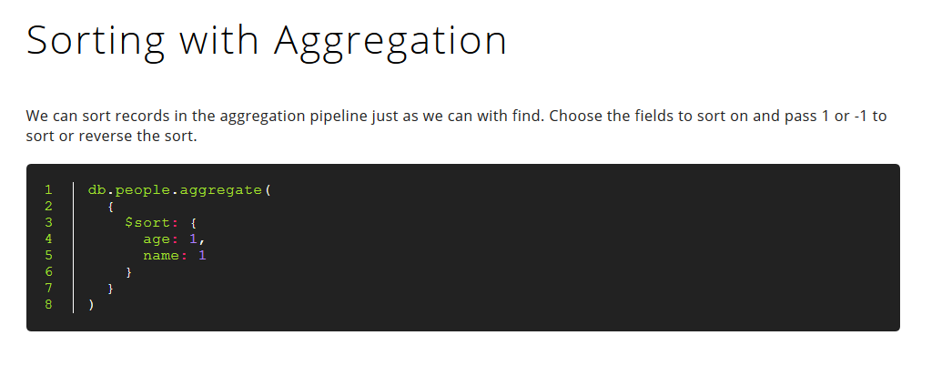

Slide 28


Slide 29


Slide 30
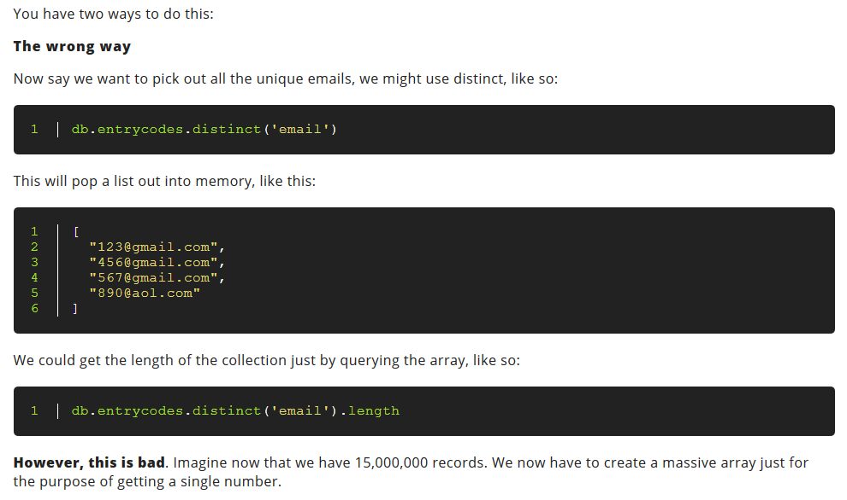

Slide 31
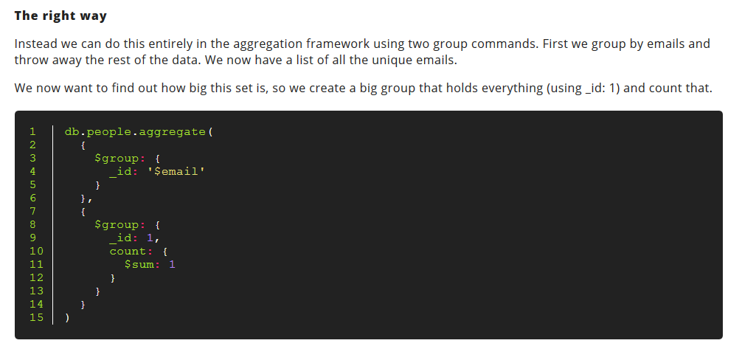

Slide 32
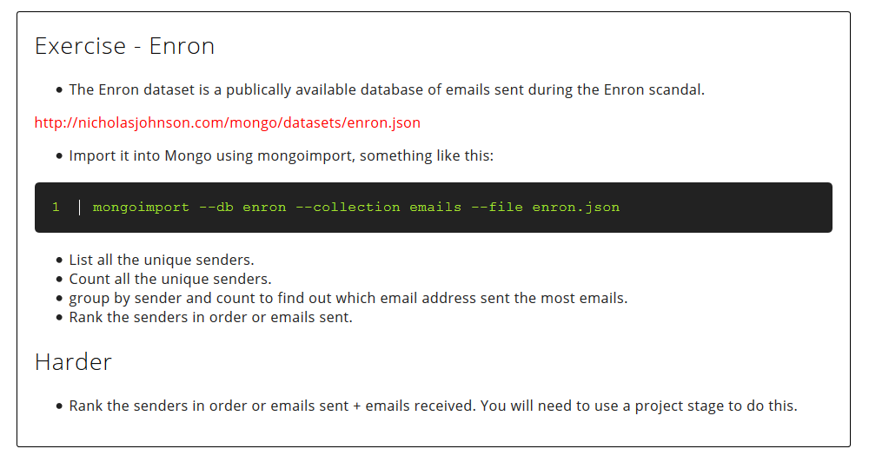

Slide 33
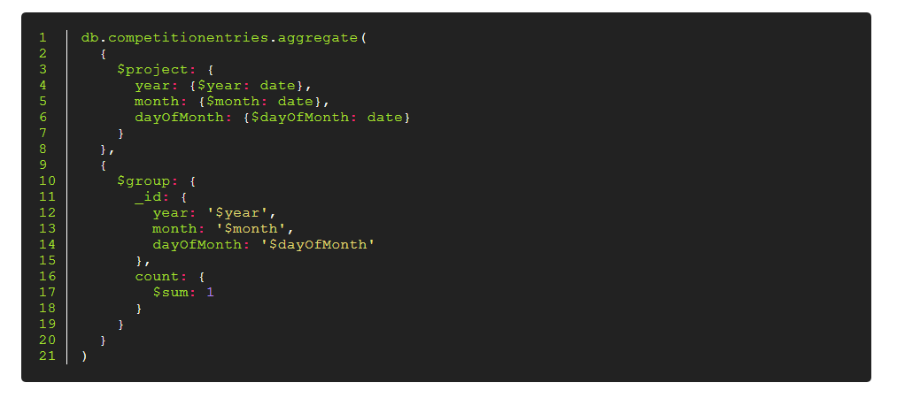

Slide 34
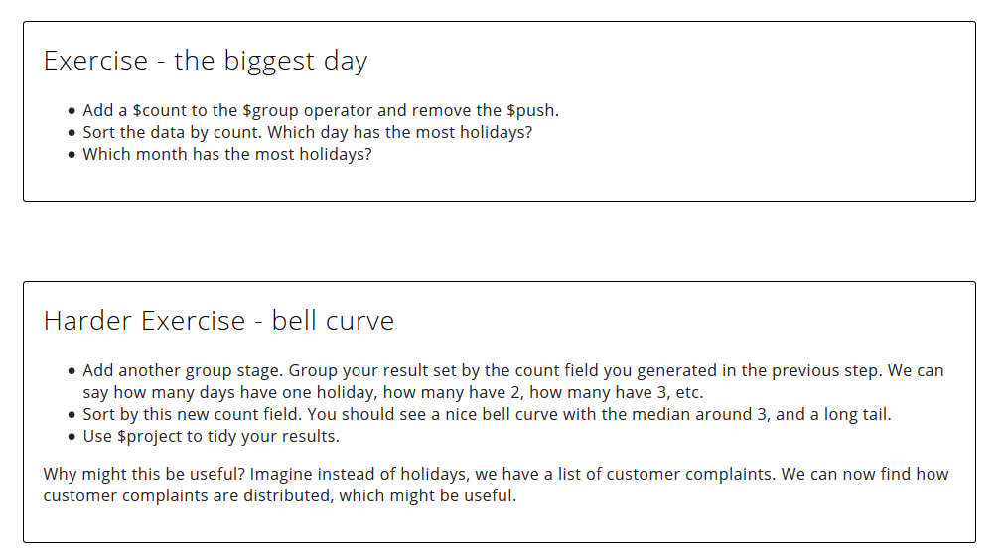

Slide 35
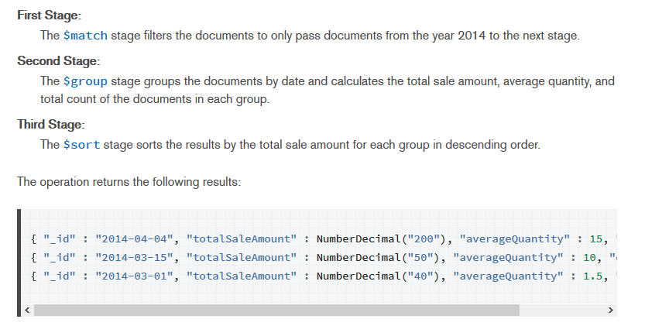
PIPELINE example

Slide 36
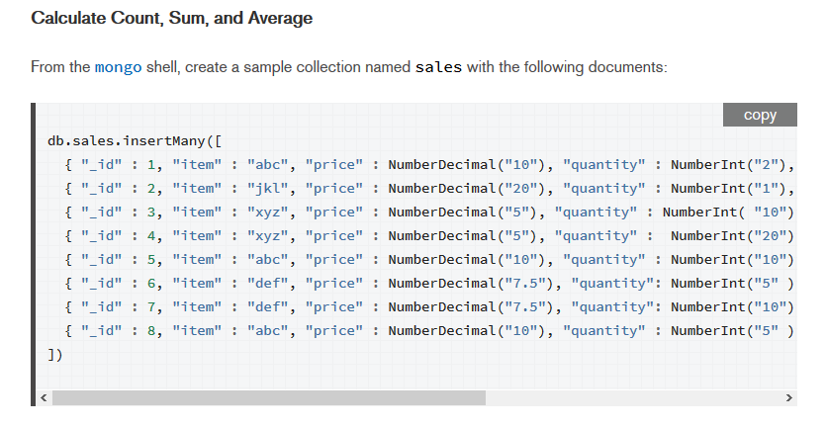

Slide 37
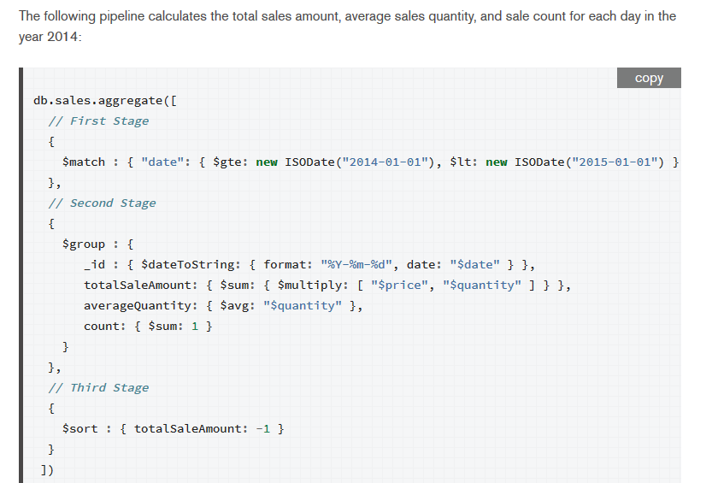

Slide 38
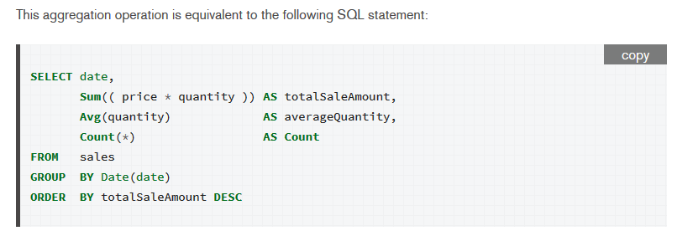

Slide 39
Lecture content adapted from https://docs.mongodb.com/manual/ & https://docs.mongodb.com/manual/reference/operator/aggregation/group/ &
http://nicholasjohnson.com/mongo/course/workbook/

